Slide 1
Database System Project
- Ajinkya Gadgil
- Saumitra Apte
- Pallavi Shirodkar
- Rucha Visal

Slide 2
Introduction- Campus Eats
The objective of this project is to create a food delivery system that will only allow authorized university staff and students to deliver the food.

Slide 3
Deliverable 1
In Deliverable 1, following steps were completed considering business rules
Data Dictionary: Data dictionary shows all the tables, their columns,data types and constraints as well as purpose of the attributes
ER diagram: ER diagram shows tables and relationship between them
Extra tables have been added. For ex. Menu, Feedback, Question and associativity tables.

Slide 4
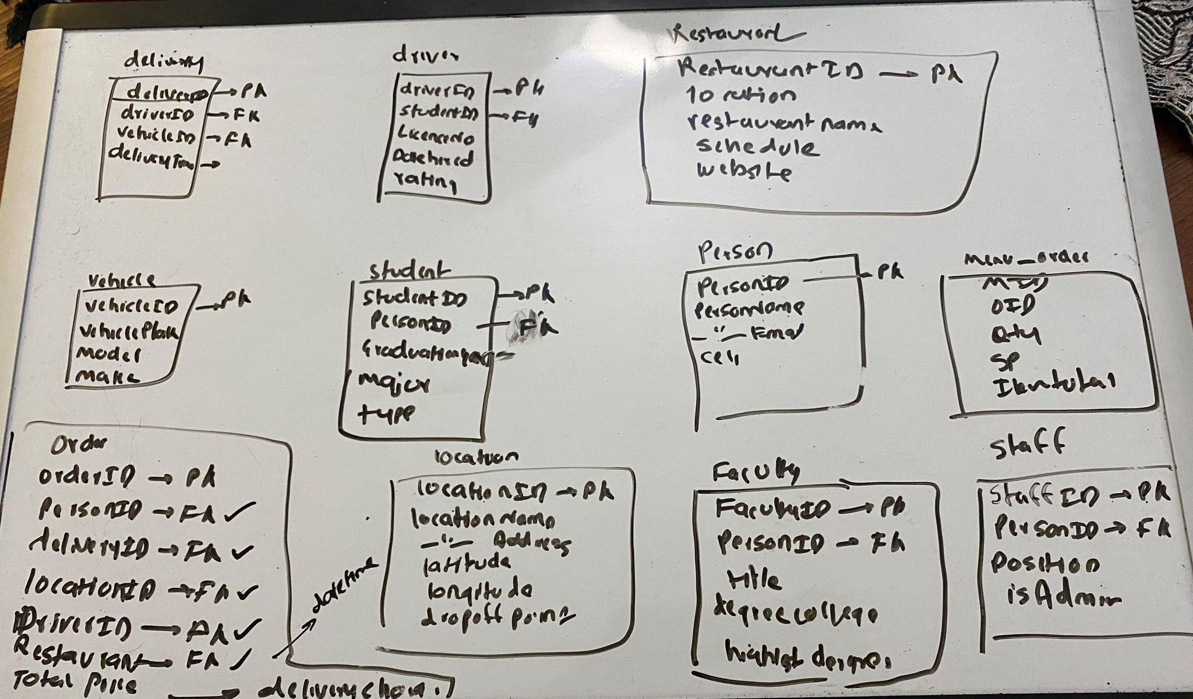
Initial Schema visualization

Slide 5
Deliverable 2
Improvement in ER diagram(Addition of new and removal of some tables)
Changes in Data Dictionary

Slide 6
Deliverable 3
Data insertion in the tables
Stored procedures, Indexes, Views and Functions have been added.

Slide 7
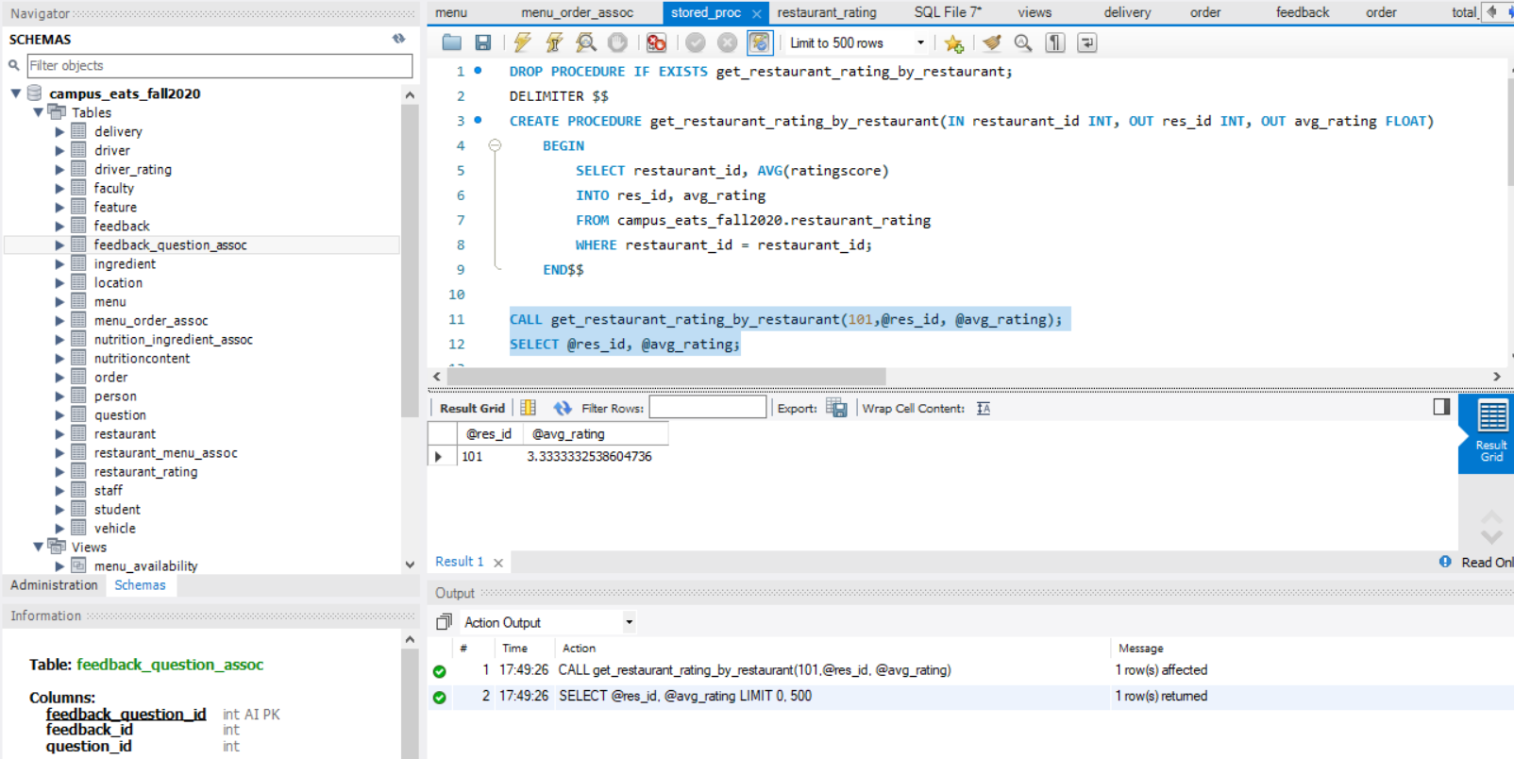
Stored Procedure 1:

Slide 8
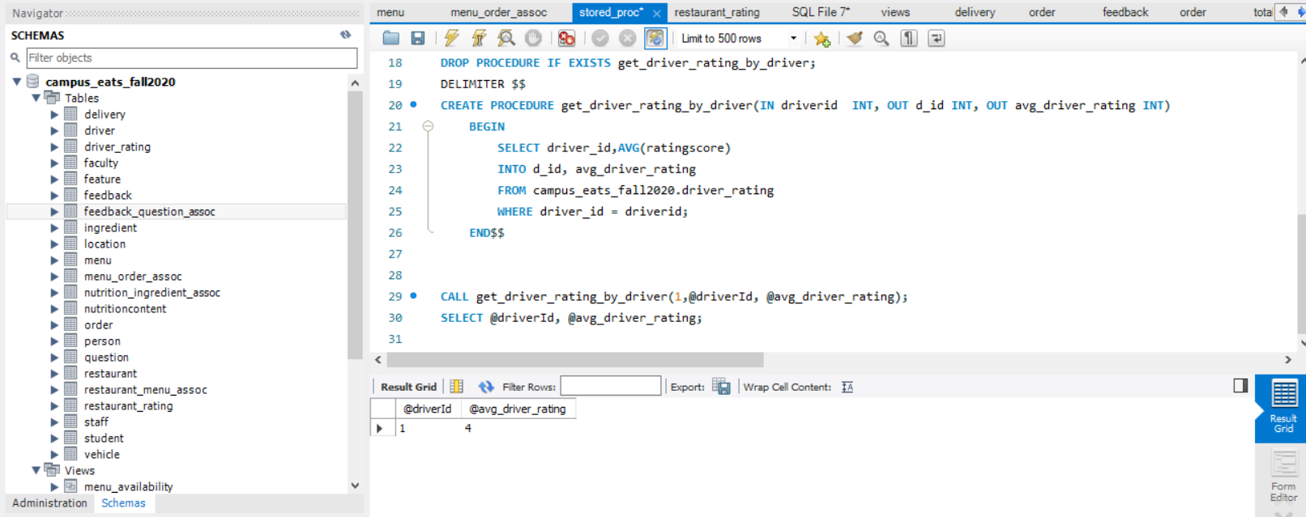
Stored Procedure 2:

Slide 9
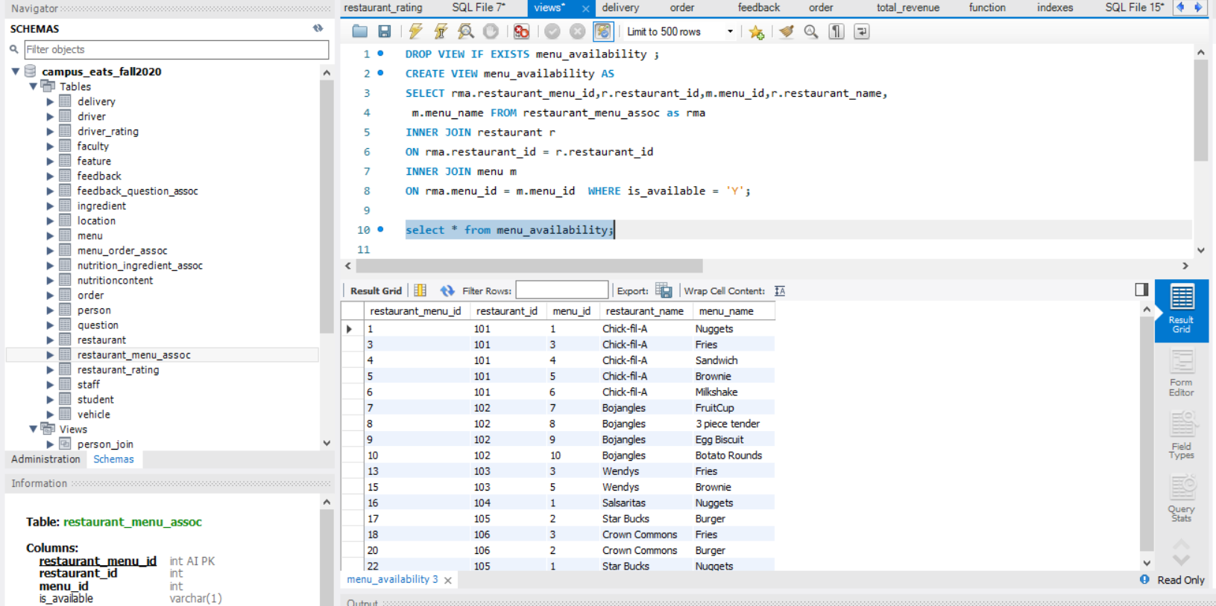
View 1:

Slide 10
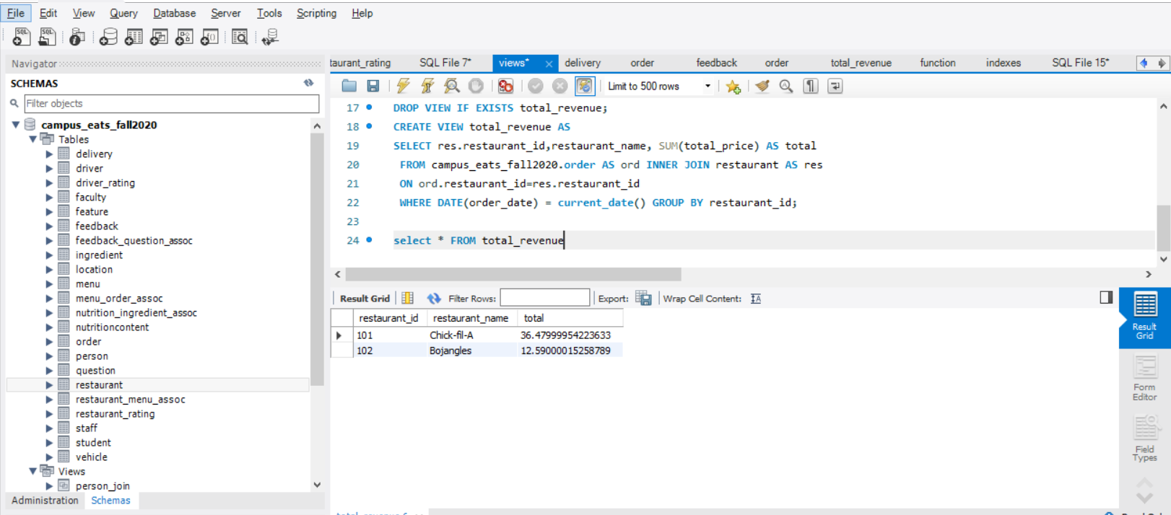
View 2:

Slide 11
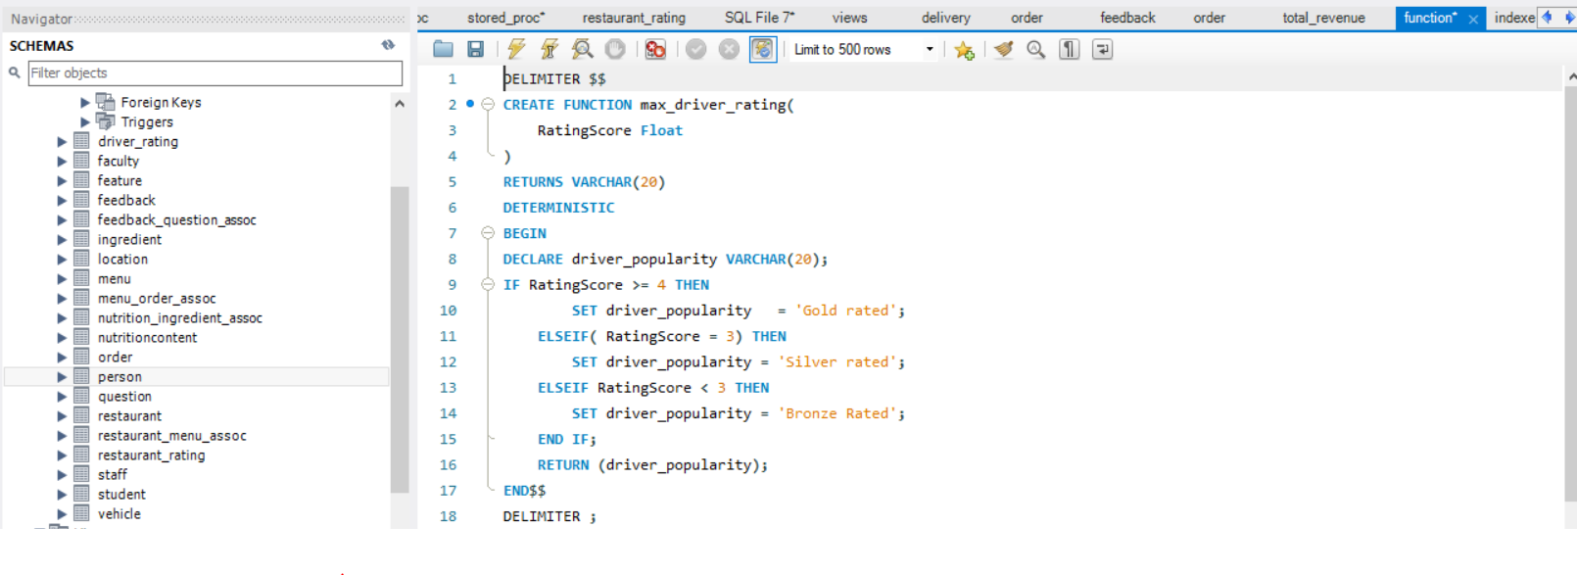
Function:

Slide 12
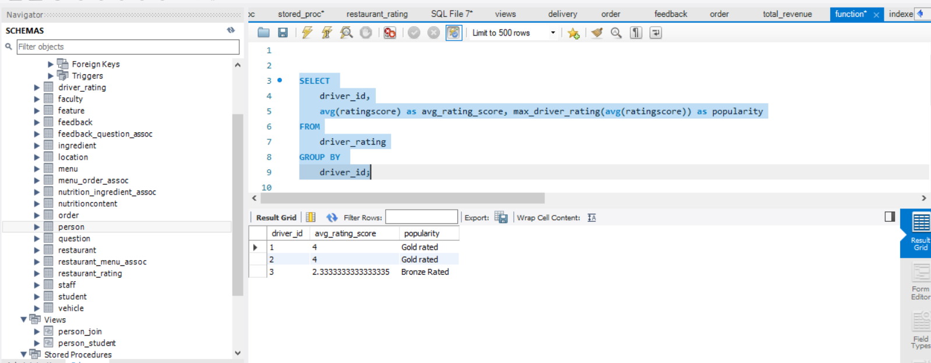
Function Call:

Slide 13
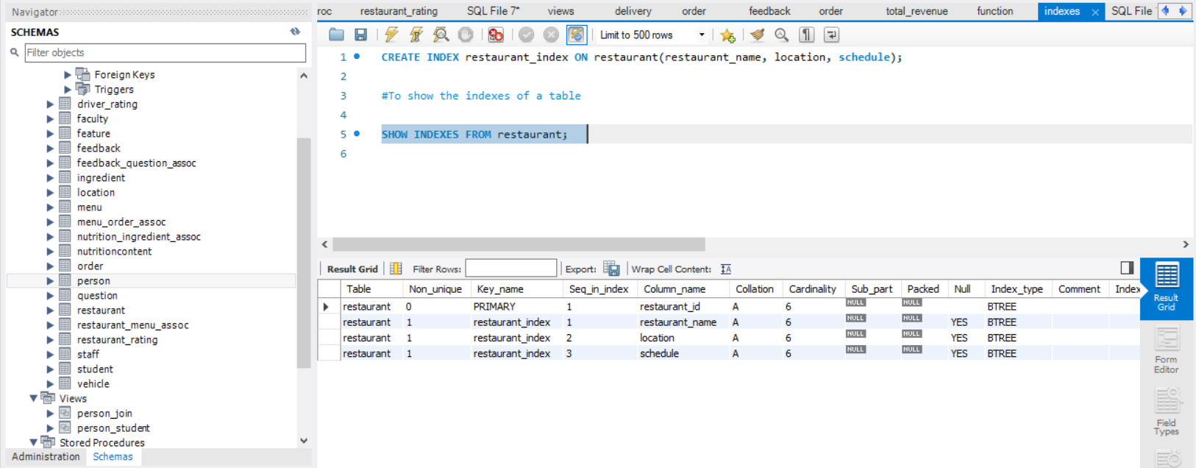
Index:

Slide 14
Thank You!

